Slide 1
Gaming Trends Over Time
Faculty of Engineering, University of Porto Master in Data Science and Enginnering | FCED Statistics
Group 5:
João Carvalho up201507023
Silvia Tavares up202204392

Slide 2
Agenda
1. Introduction 2. Research question
3. Data Source 4. Data Exploration
5. Inferences 6. Conclusion

Slide 3
1. Introduction | Video Games Market Evolution
The start
Smartphones
Before 1970, there was no significant commercial aspect to the video game industry.
Penetration of smartphones has made video games more accessible, portable, and social.
Interactive gaming
5G Network
2000 to Present
Computer-based interactive gaming machines used other mechanisms to imitate a screen.
5G network boosted the number of gamers around the globe.
Electronic gaming industry has constantly expanded due to online gaming.

Slide 4
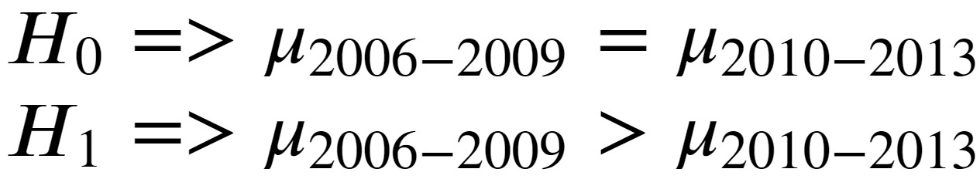
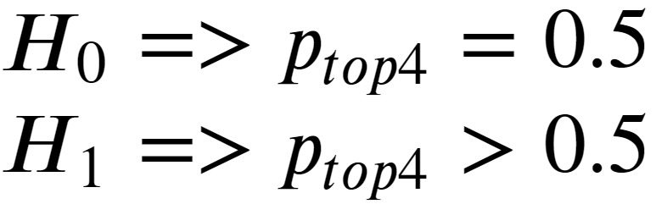
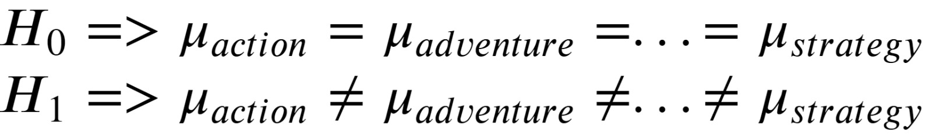
2. Research Question
What are the major characteristics of the video games market within the major console's lifecycle of 2006-2013?
Numerical Variables - Global Sales, User Score, Critic Score, Year of Release
Categorical Variables - Platform, Genre, Publisher
1) Do users tend to rate PS3 and Xbox 360 games higher at the beginning of the console's lifecycle, since it's a novelty?
2) Do the top 4 publishers hold the majority of market share in games sold between 2006 and 2013?
3) Are there certain genres for which critics tend to rate games differently, on average, in comparison to other genres?

Slide 5
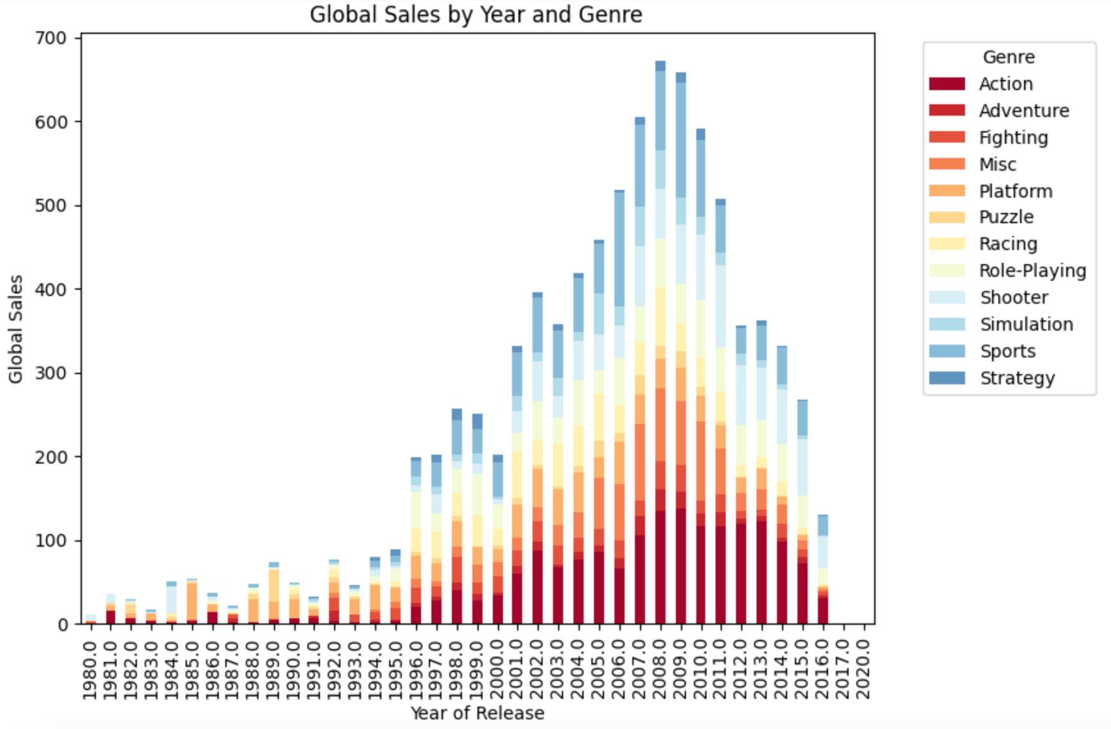
3. Data Source
4. Data Exploration
The dataset that was used for this project is the Video Games dataset . It has 16719 rows and 16 columns. Columns: - Name, Platform, Year of release, Genre, Publisher, Sales in North America, Europe, Japan, and other regions; - Critic score, Critic Count, User score, User Count, Developer, and Rating .

Slide 6
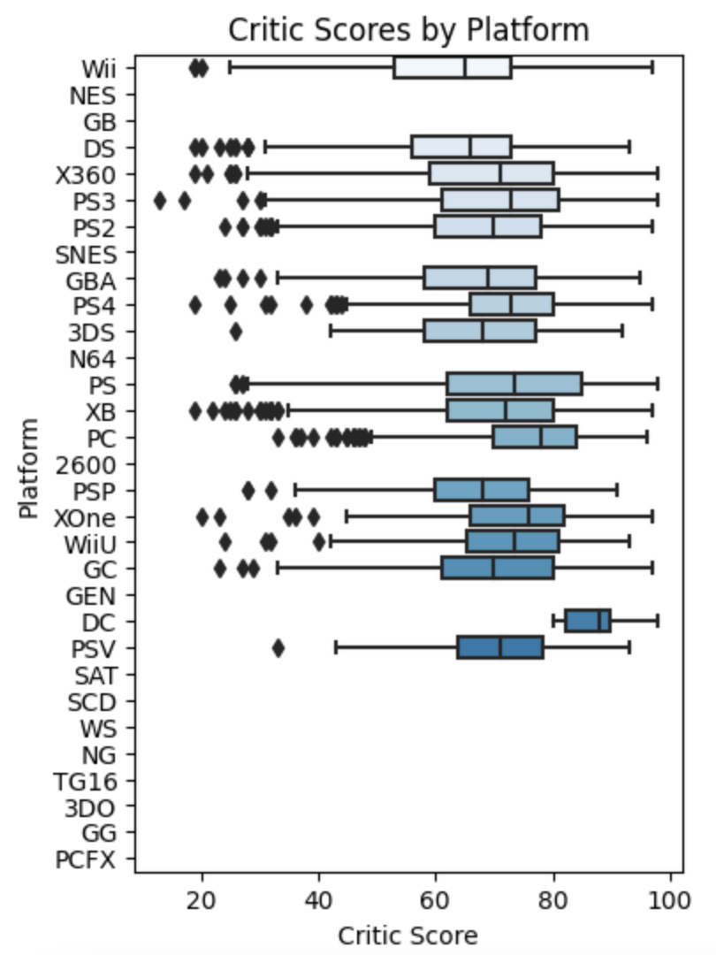
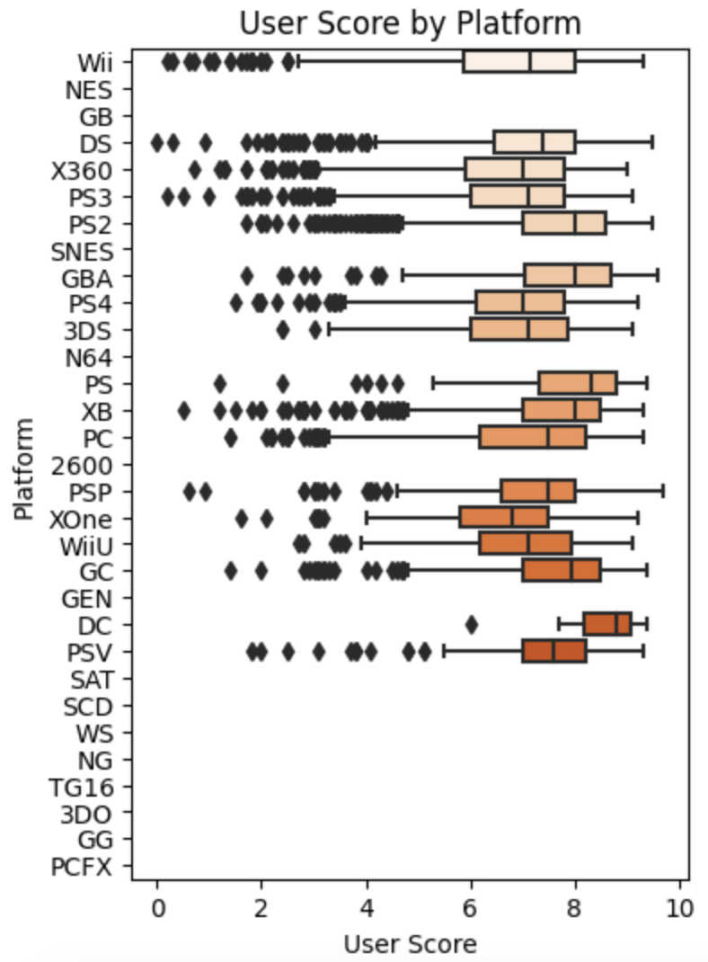
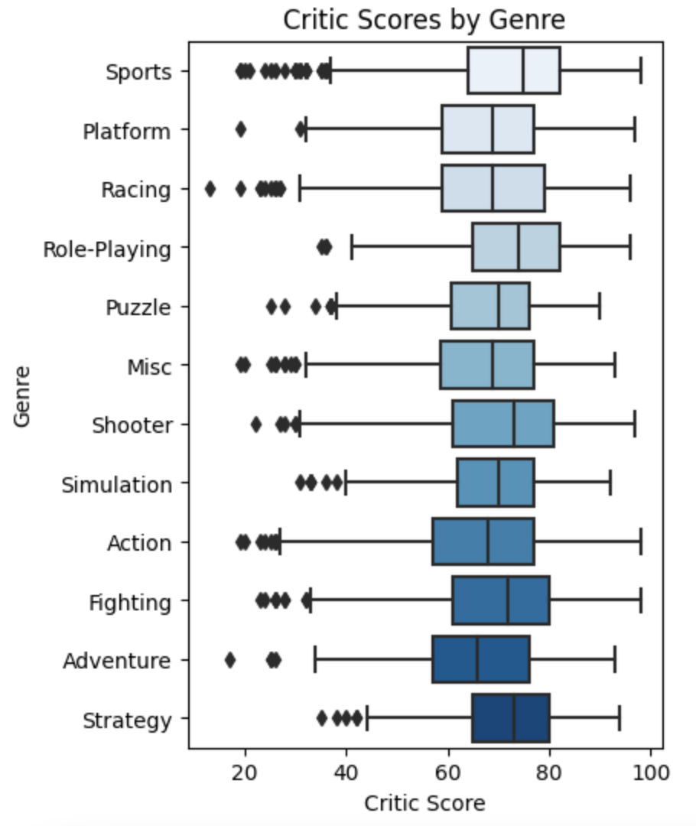
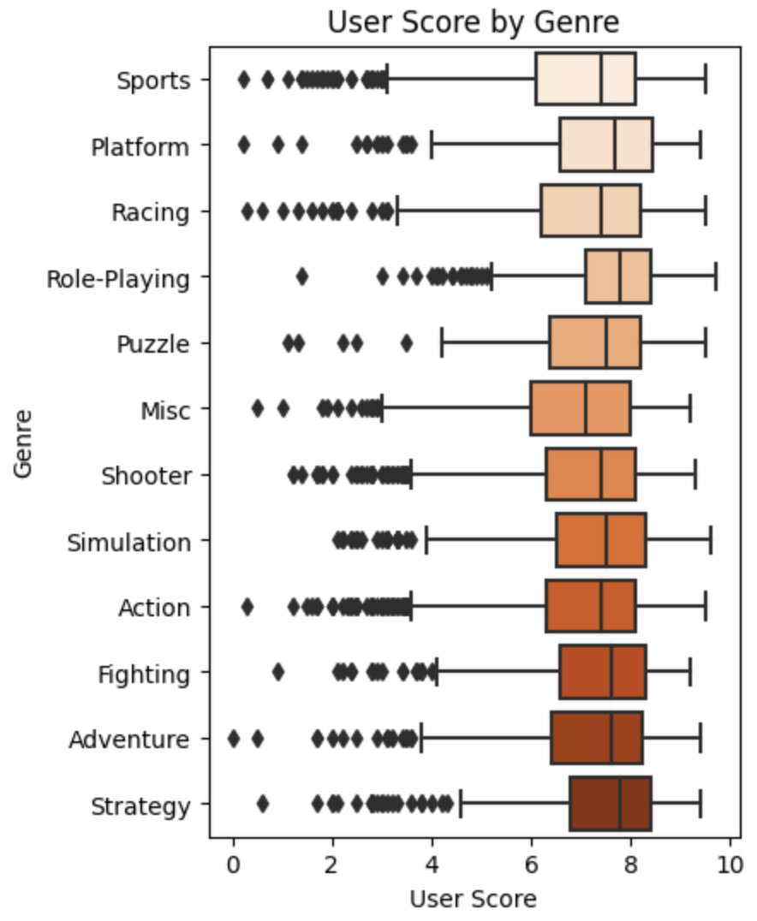
4. Data Exploration
Platform: Checking the distribution for Critics and User Score
Genre: Checking the distribution for Critics and User Score

Slide 7
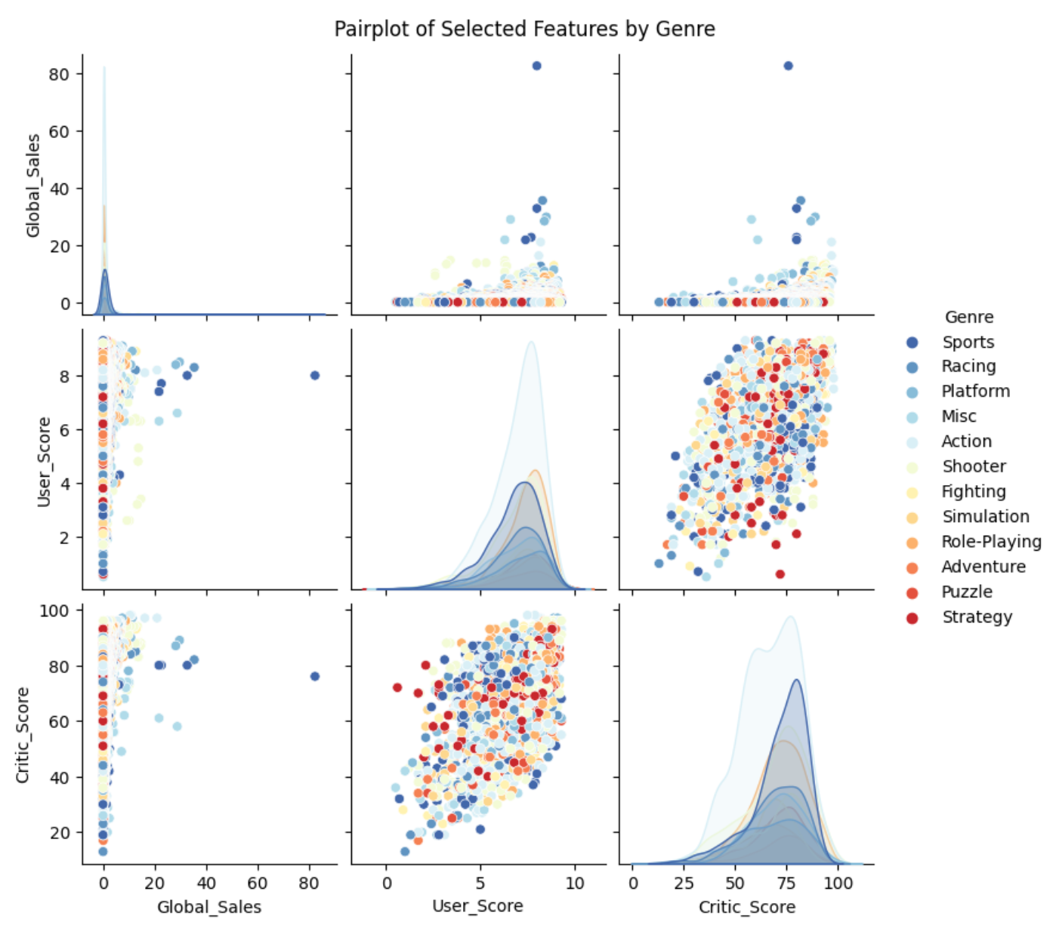
4. Data Exploration | Variable Selection
Missing Value
Based on the questions that we want to answer the following variables were selected from 2006 to 2013:
Numerical - Global Sales, User Score, Critic Score, Year of Release
Categorical - Publisher, Platform, Genre
For this project we will drop the missing and the reasons why we decided to do that are:
Data Completeness;
Assumption Violation;
Bias Reduction;
Simplification.

Slide 8
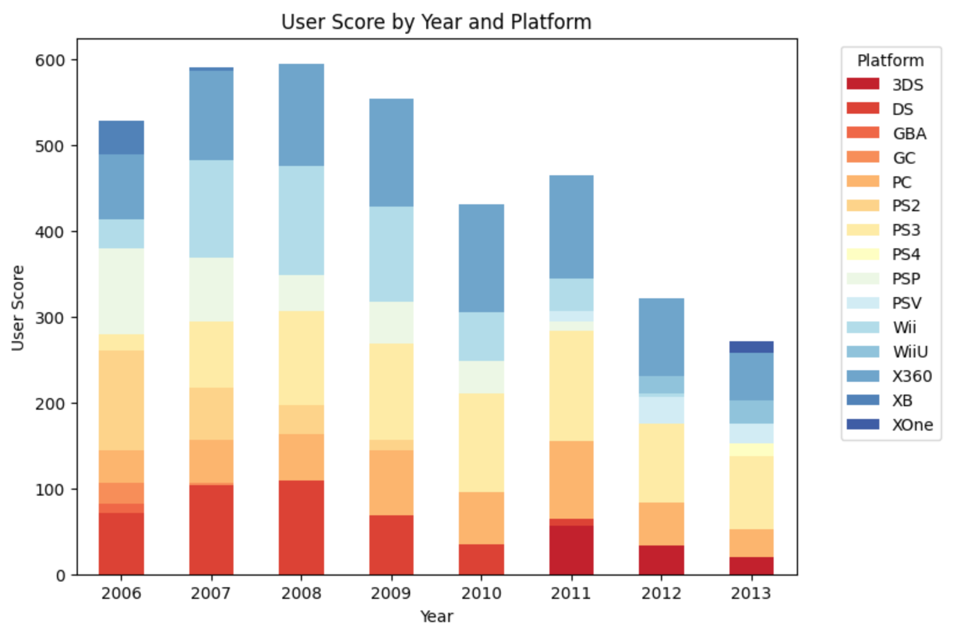
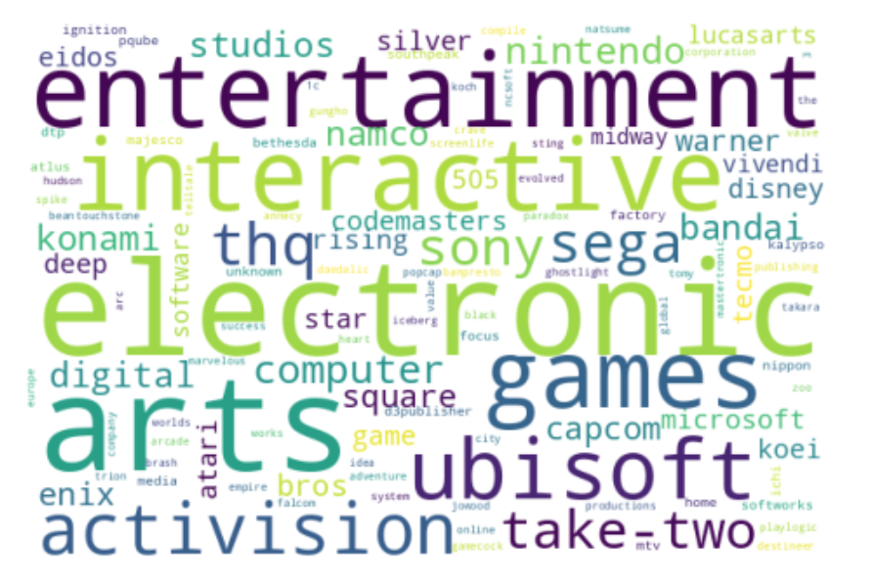
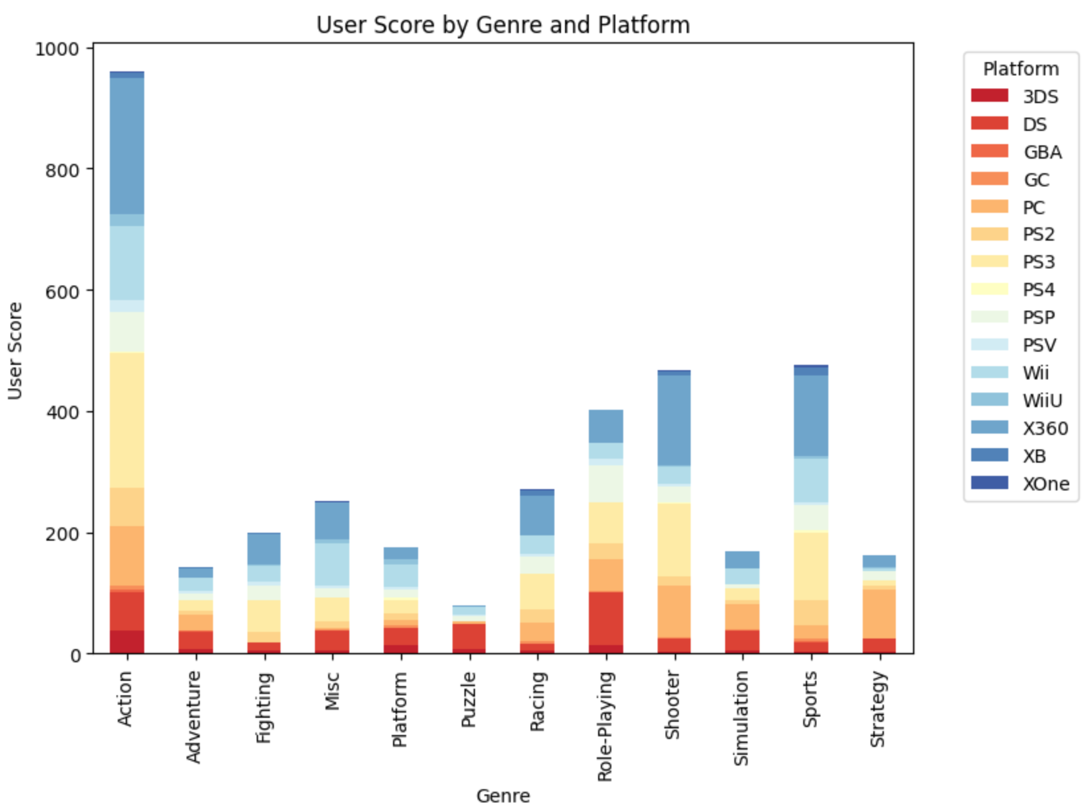
4. Data Exploration | Variable Selection
Word Cloud for Publisher:

Slide 9
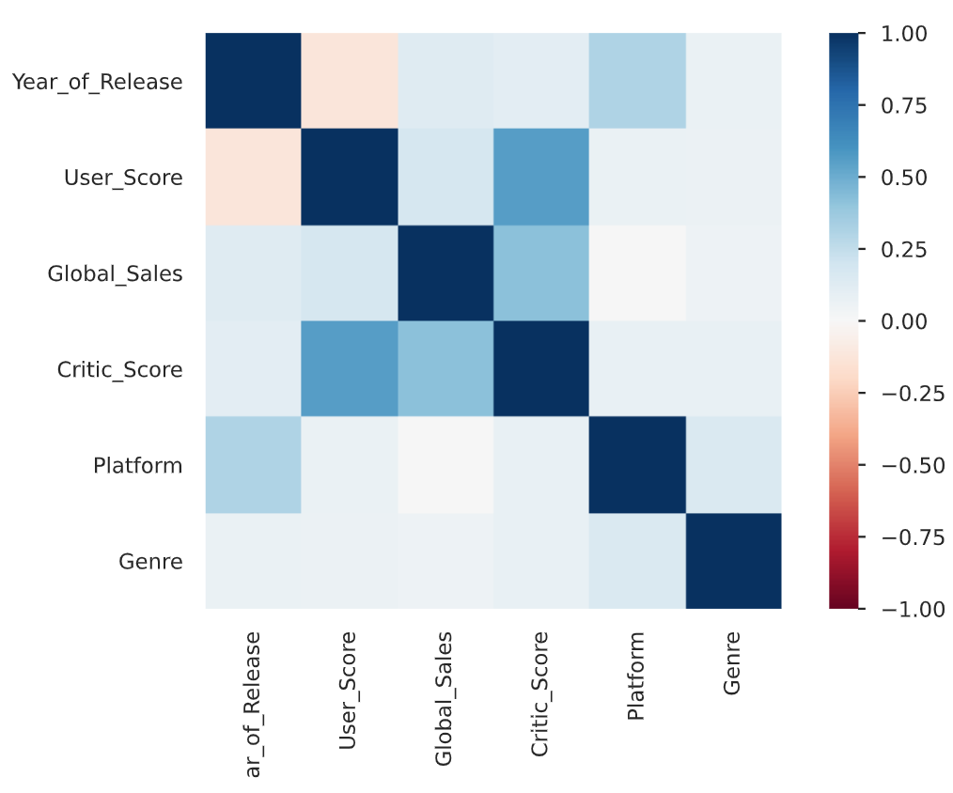
4. Data Exploration | Correlation
The two higher correlation coefficients are the following:
"User Score" and "Critic Score"
A correlation coefficient of 0.556 suggests that there is a moderate positive relationship, when a game receives higher scores from users, it tends to also receive higher scores from critics, and vice versa.
"Global Sales" and "Critic Score"
The correlation coefficient of 0.428 indicates a moderate positive relationship, when a video game receives higher critic scores, it tends to achieve significantly higher global sales.

Slide 10


5. Inferences | Research Question 1
Do users tend to rate PS3 and Xbox 360 games higher at the beginning of the console's lifecycle, since it's a novelty?
Independence
The period chosen is not random, however we assume this dataset represents a random sample of videogames. Therefore, if we assume this dataset also represents a period that is roughly equivalent to any other console's lifecycle, independence is reasonable to assume.
Normality
We assume the dataset to be a random sample and with a sample of hundreds of user scores for every relevant period, we verify the normality condition.

Slide 11
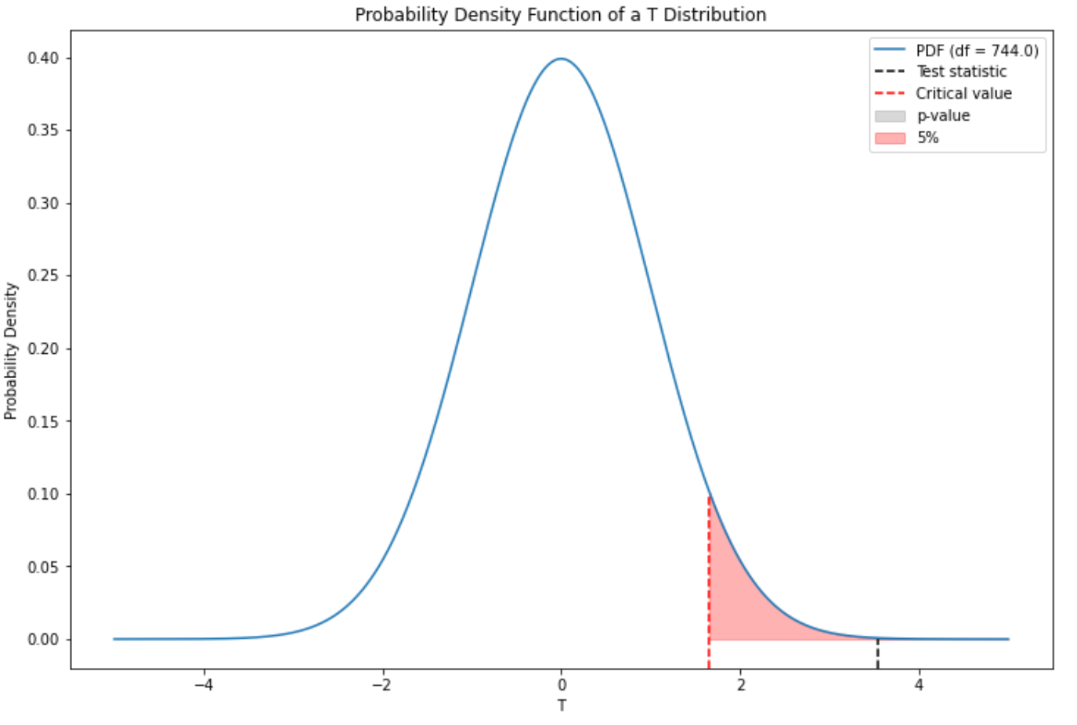
5. Inferences | Research Question 1
T-statistic = 3.55
T-critic = 1.64
P-value= 0.02%
Reject H0. The data provides strong evidence that for PS3 and Xbox 360 their lifecycle period, users tended to attribute a higher score in the first 4 years, compared to the last 4 years of the cycle.
Confidence Interval: (0.10934, 0.37931)
Running T-statistic for 3 different sample sizes between 30 and 1000. 7 out of 9 test rejected H0.

Slide 12

5. Inferences | Research Question 2
Do the top 4 publishers hold the majority of market share in games sold between 2006 and 2013?
Independence
We assume this dataset represents a random sample and that the videogame sales are independent between each publisher. With this, we meet the first condition.
Success-failure
This second condition is also met, since both successes and failures are above 10.

Slide 13
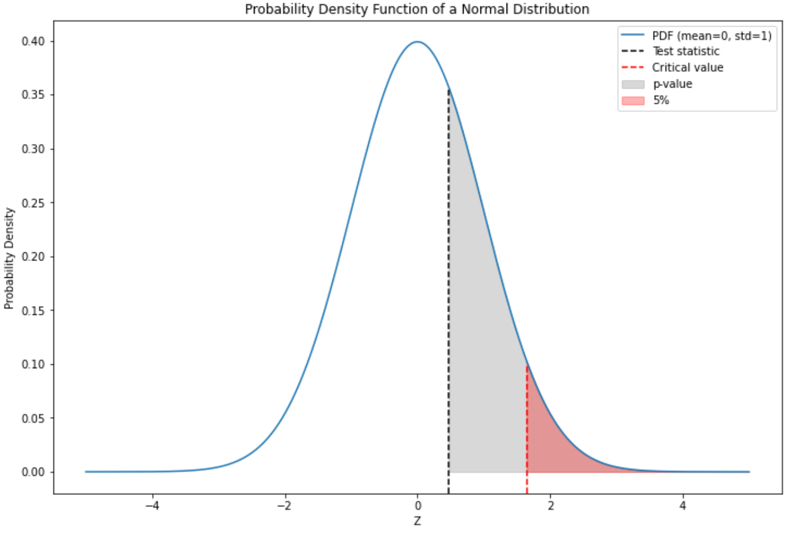
5. Inferences | Research Question 2
Z-statistic = 0.47
Z-critic = 1.64
P-value= 32%
Fail to reject H0. The data provides consistent evidence that we can't say that the true market share of the top 4 publishers between 2006 and 2013 is over half of the market.

Slide 14

5. Inferences | Research Question 3
Are there certain genres for which critics tend to rate games differently, on average, in comparison to other genres?
Independence
We assume this dataset represents a random sample and that videogame critic scores are independent between each other. The first condition, independence, is met.
Normality
The distributions of critic scores is fairly symmetric within each genre which indicates they are approximately normal distributions.
Constant Variance
The constant variance condition is also met as the computed standard deviations are similar across the board every distribution of critic scores per genre.

Slide 15
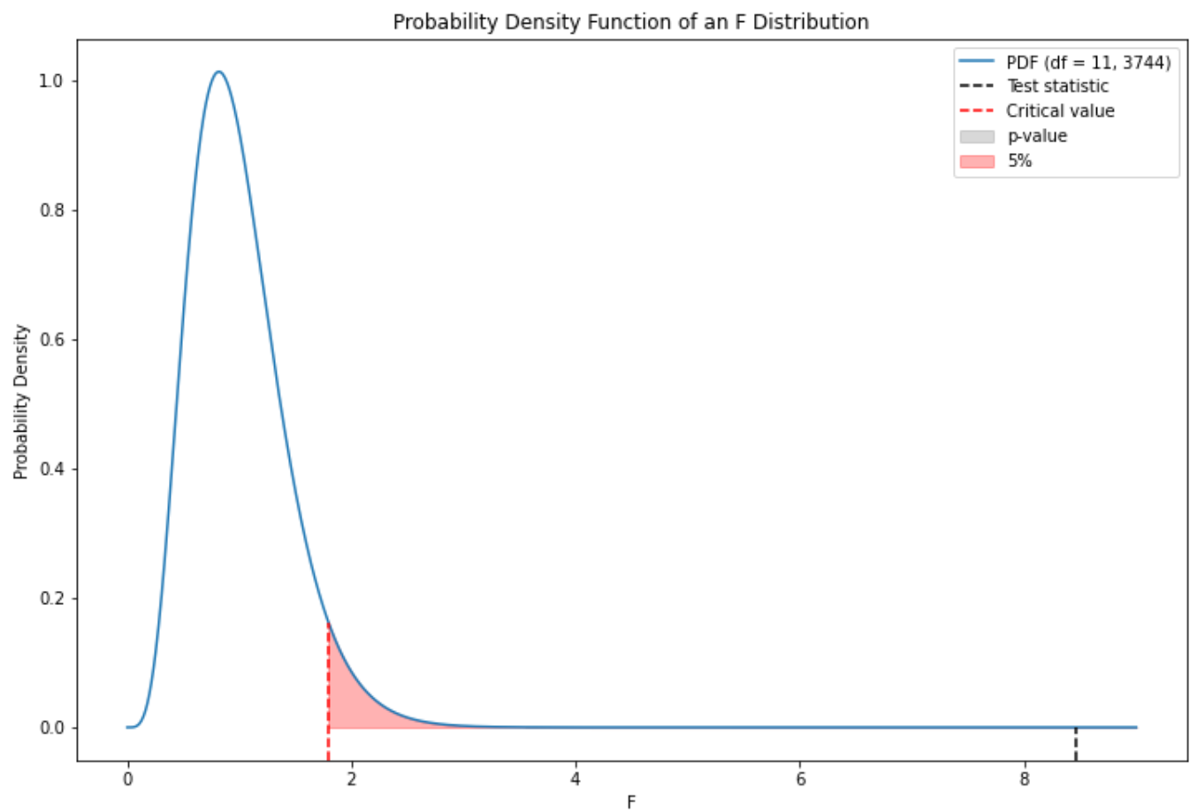
5. Inferences | Research Question 3
F-statistic = 8.46
F-critic = 1.79
P-value= 6.7e-15
Reject H0. We can confidently say that for the period in question, the average critic score of video games varies across some, or every, genre.

Slide 16




6. Conclusions
User Engagement
Users tend to rate games on the PS3 and Xbox360 higher at the beginning of the console's lifecycle, we suspect due to the novelty factor. This highlights the importance of the initial phase of a console's lifecycle in terms of user engagement.
Market Concentration
The market is not dominated by a small number of publishers but rather comprises a wide range of developers and publishers with varying market shares.
Genre Influence
Different genres have distinct characteristics and appeal to critics and players in unique ways.

Slide 17

Thank You !!

